Slide 1



Introduction to Computational Social Science
Computational Social Science
by Talha Oz
May 2014, Princeton University
Second GrandEng Workshop

Slide 2
CSS: Three fundamental challenges
Computational modeling
Complexity of theoretical issues in social sciences
Santa Fe Institute, George Mason University
Analysis of social observational data
Knowledge discovery and data mining
Cell phones, emails, blogs, OSN services
Virtual lab–style experiments
Handling large scale social experiments
Experimental macrosociology, crowdsourcing (AMT)
This 3-fold categorization is done by D. J. Watts, “Computational Social Science Exciting Progress and Future Directions,” Bridge Natl. Acad. Eng., vol. 43/4, Winter 2013

Slide 3
Computation in Social Sciences
Computation in theory / empirical tools
Social network analysis (SNA)
Geospatial analysis, social GIS
Information retrieval, web scraping
Machine learning, data mining
Computational linguistics
Computation as theory / a theoretical tool
Modeling the behavior of the individuals & institutes
Capturing emergent behaviors of groups & societies

Slide 4
Why Model? [Epstein]
You are a modeler
Who projects or imagines how a social dynamic would unfold is running some model
Assumptions are hidden, internal consistency untested, logical consequences & relation to data is unknown
17 reasons to build models
Predict, explain, guide data collection, illuminate core dynamics, suggest analogies, freedom to doubt, etc.
“Art is a lie that helps us see the truth” Picasso

Slide 5
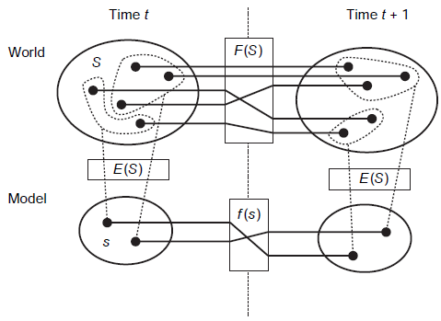
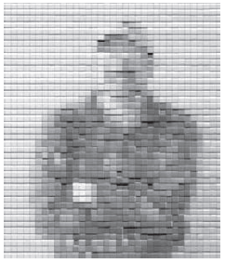
Prelim I – Social Complexity
Models
Selected attributes
Emergence
Reductionism (!)
Tiles in tiles…
Complex Adaptive Systems
Complexity. Interactions add value i.e. not in the system
Adaptivity. Intelligence of components
Traditional modeling approaches
Detailed verbal descriptions, mathematical analysis, thought experiments, models derived from first principles
Miller & Page. Complex Adaptive Systems

Slide 6
Prelim II - Neoclassical Economics
Three assumptions in neoclassical economics
People have rational preferences
Individuals maximize utility & firms maximize profits
People act independently with full and relevant info.
Mathematical constraints
Agents subsumed into a single representative agent
Computation used to solve numerical methods

Slide 7
Agent-based Modeling
Agent is an object that represents an individual/institution
Autonomous (unlike DES)
Own features & behavior [OOP: attributes & methods]
Rationally bounded; limited vision
Decision-making strategies; learning algorithms
Agent-agent & agent-environment interaction
Simulation environment & time
Abstract or spatially explicit models (GIS incorporated)
Neighborhood size; social network
A step might be in seconds, days, years, etc.
At each step agents are activated in some order
ABM Frameworks: NetLogo, MASON, RePast, Swarm, etc.

Slide 8
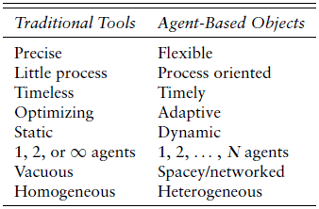
Why ABM?
Flexibility versus Precision in describing the phenomena
Flexible long verbal descriptions to precise mathematical tools
OOP: very flexible in capturing a variety of behaviors
Process Oriented
How agents interact, when, with whom
Vision; information an agent has access to
Adaptive Agents
Rationally bounded. Learning Algorithms
Inherently Dynamic
In natural systems, equilibrium = death
Heterogeneous Agents and Asymmetry
Old tools implicitly have homogeneity
Scalability
Mathematical models for a few (duopolies) or many (perfect competition) agents
Repeatable and Recoverable
Initial state can be recovered; experiments can be repeated precisely
Constructive (analogy: proof by construction vs proof by contradiction)
Generative approach is a distinct and powerful way to do social science
Low Cost (create. Repeat), economic E. coli (E. coni?)
Miller & Page. Complex Adaptive Systems

Slide 9
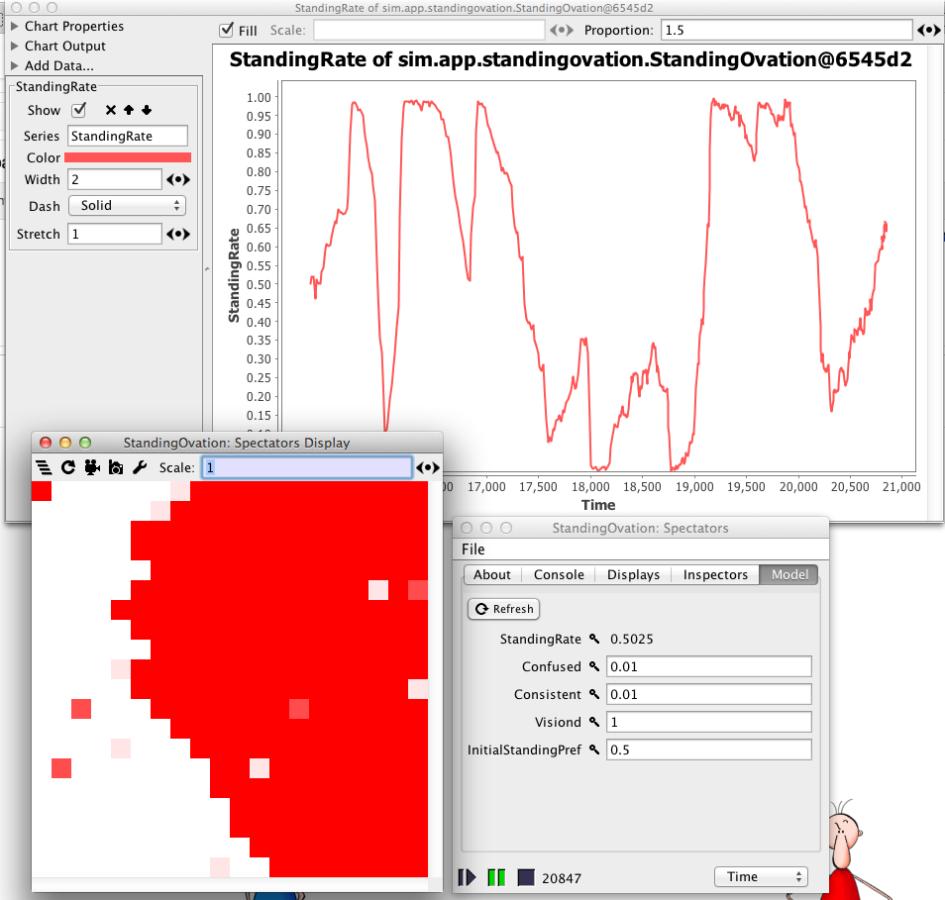
DEMOS
Agent-based modeling
Ants foraging [NetLogo]
Standing ovation problem
Social media analysis
Turkish media readership

Slide 10

Recommended Short Readings
Computational Social Science Exciting Progress and Future Directions
D. J. Watts, Bridge Natl. Acad. Eng., vol. 43/4, Winter 2013

